Slide 1

MOODLE – Our e-learning platform

Slide 2
Moodle - overview
Understand Moodle and how to use it
How to access the system (Login)
Activities in Moodle:
Assignments
Examination
Quiz
Chat
Forum
Lesson
etc

Slide 3
WHAT IS Moodle?
A Course Management System (CMS), also known as a Learning Management System (LMS)
Provides Course structures
Manage course contents (add resources, add activities)
Manage user records (grade report, user usage records)

Slide 4
Moodle as a platform
An Open Source Course Management System
Contains tools to support learning & teaching
It is a tool for creating online learning .

Slide 5
activities in Moodle
Assignments
- can be specified with a due date,
Types: Advanced upload files, Online text, upload single file, and Offline activity
Assessment can be done
Teacher feedback given
Notification can be mailed out

Slide 6
activities…
Chat
Allows smooth, synchronous text interactions
Includes profile pictures, images etc.. in the chat window

Slide 7
activities…
Forum module:
The forum module is an activity where students and teachers can communicate/exchange ideas by posting comments.
Forum posts can be graded by the teacher or other students.
Types include: News Forum for staff, Social forum, question forum, discussion forum

Slide 8
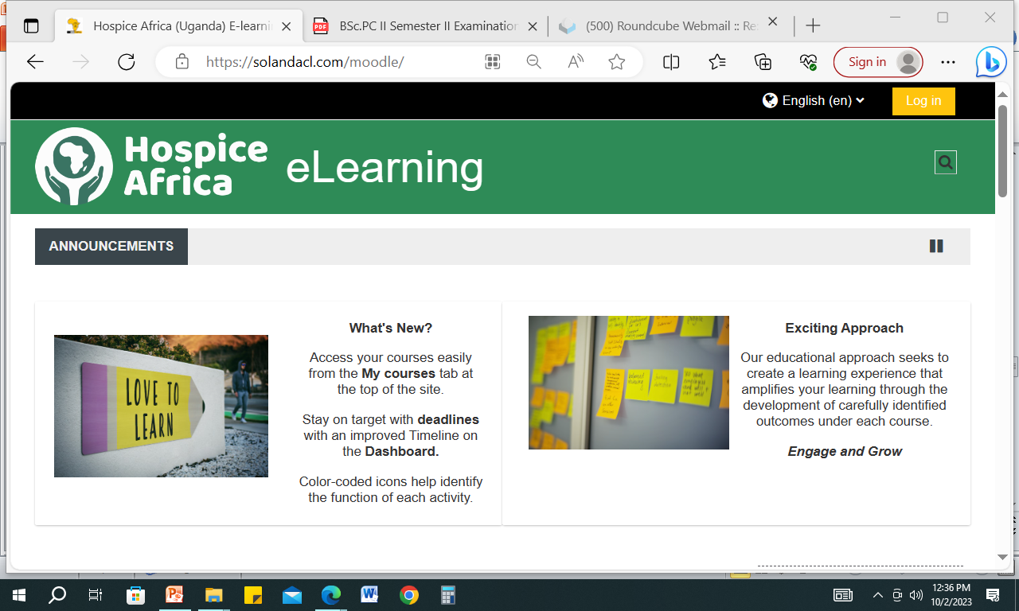
https://solandacl.com/moodle/ https://solandacl.com/moodle/
Access with – https://solandacl.com/moodle

Slide 9
How to creat a password
A password should at least have 8 characters , from each of the following four categories:
1. Uppercase letters A, B, C
2. Lowercase letters a, b, c
3. Numbers 0, 1, 2, 3, 4, 5, 6, 7, 8, 9
4. Symbols - all keyboard characters not defined as letters or numerals) and spaces ~ ! @ # $ % ^ & * ( ) _ - + = { } [ ] \ | : ; " ' < > , . ? /

Slide 10
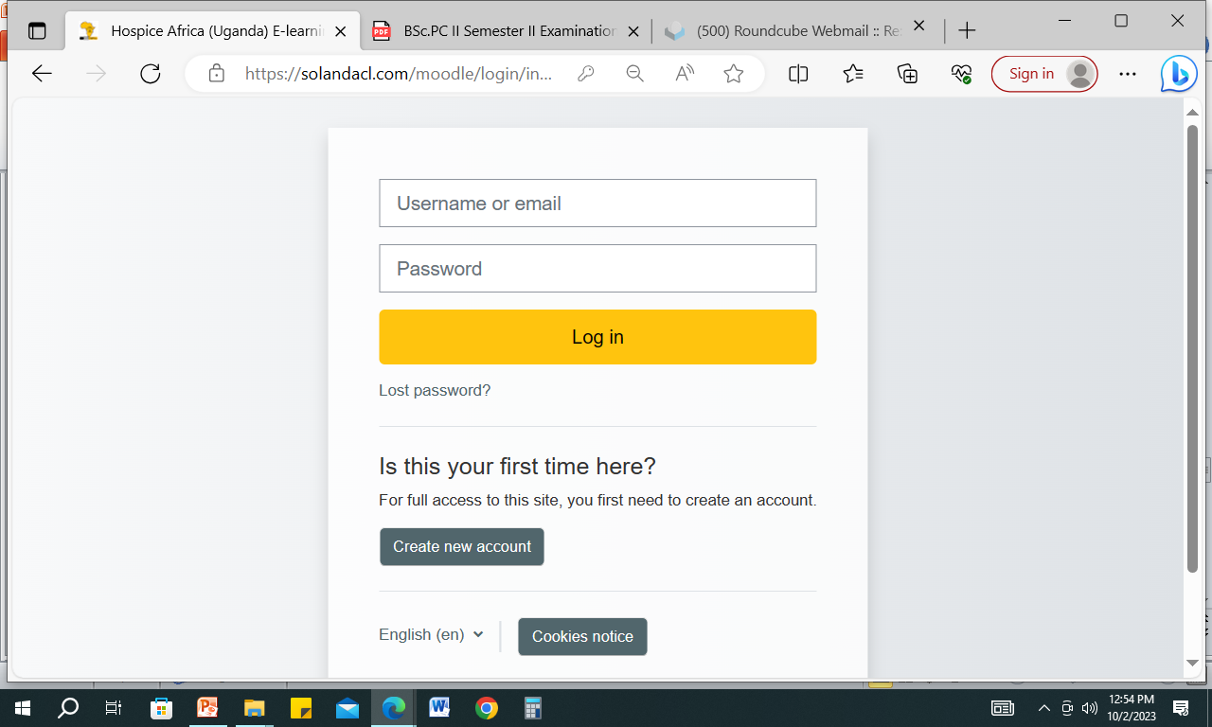
Enter username and password here
How to login
Usename
Password
User name
Pass word

Slide 11
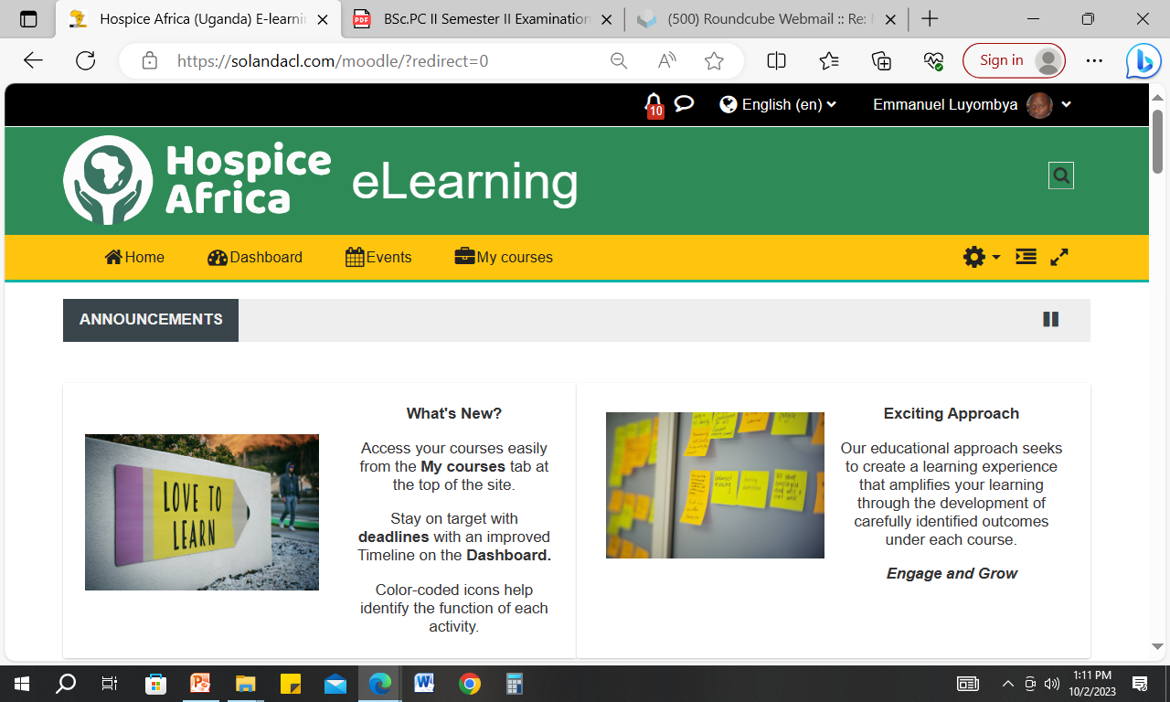
Loged in – Front page

Slide 12
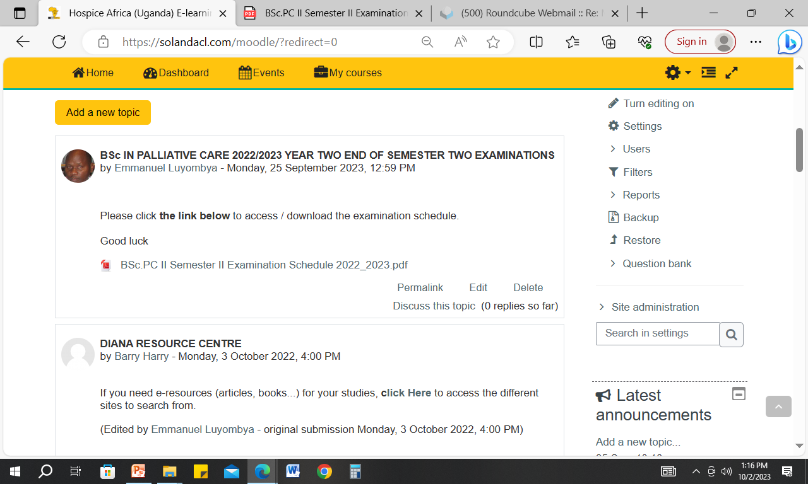
Front page – General info

Slide 13
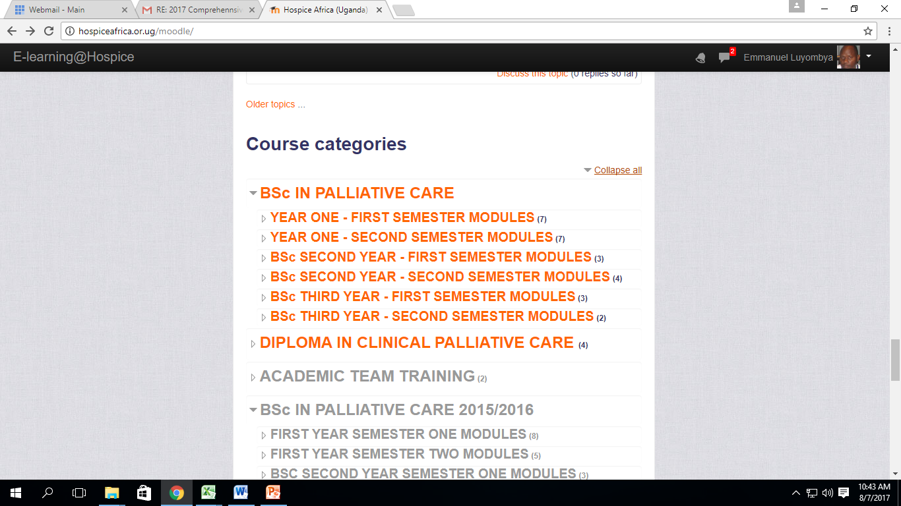
Expand to access course modules
Course categories & courses

Slide 14
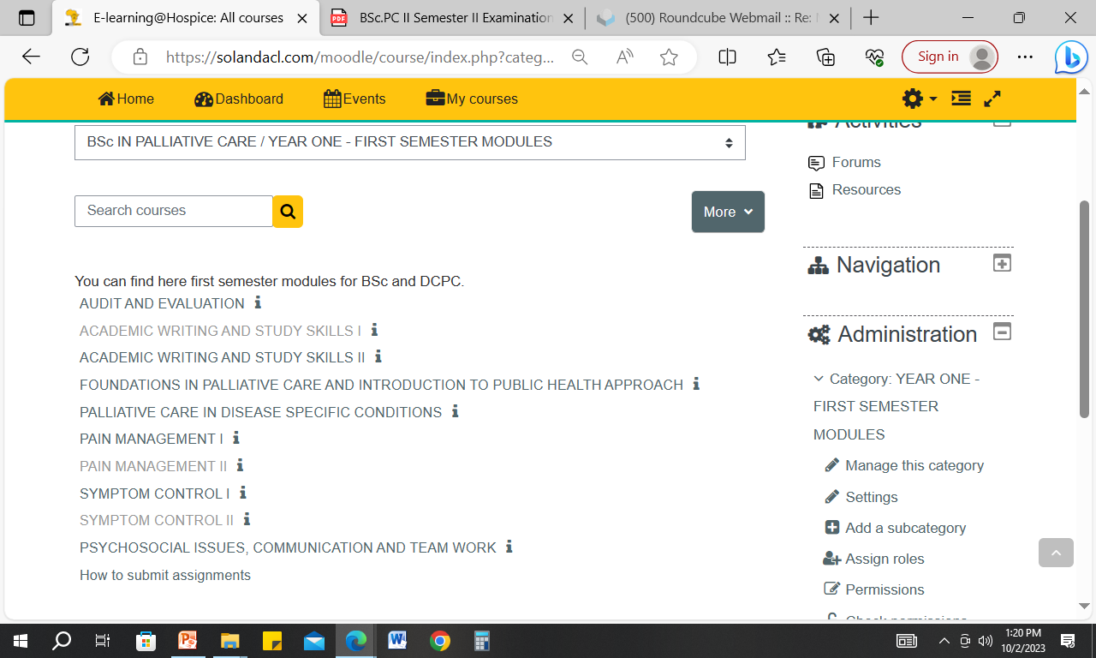
Access the courses

Slide 15
Username and password
Username:
First later of first name
Surname
Password:
Uppercase letters
Lowercase letters
Numbers
Symbols
Minimum of 8 characters

Slide 16
SAFE EXAMINATION BROWSER
FOR STUDENT

Slide 17
SOME FEATURES OF SEB
Safe Exam Browser is a customised web browser
The application must be downloaded and installed on the device that the student uses to attempt the quiz.
Students will only be able to attempt the quiz if they are using Safe Exam Browser.
The browser window won't have a URL or search field and back/forward navigation.

Slide 18
SOME FEATURES OF SEB….
Safe Exam Browser cannot be closed until the test is submitted.
Switching to other applications is disabled by default
Shortcut keys such as Win+Tab, Alt+Tab, Ctrl+Alt+Del, Alt+F4, Print Screen, Cmd+Tab are disabled or cannot be used to close Safe Exam Browser or to switch to other user accounts on the computer.

Slide 19
SOME FEATURES OF SEB…..
The possibility of taking screen shots is disabled.
The clipboard is cleared when starting and quitting Safe Exam Browser.

Slide 20
Student – SEB configuration
Download the Safe Exam Browser – the file.
Launch the Safe Exam Browser - this applies the settings and sends the students to the quiz starting page.
Return to the Moodle course.

Slide 21
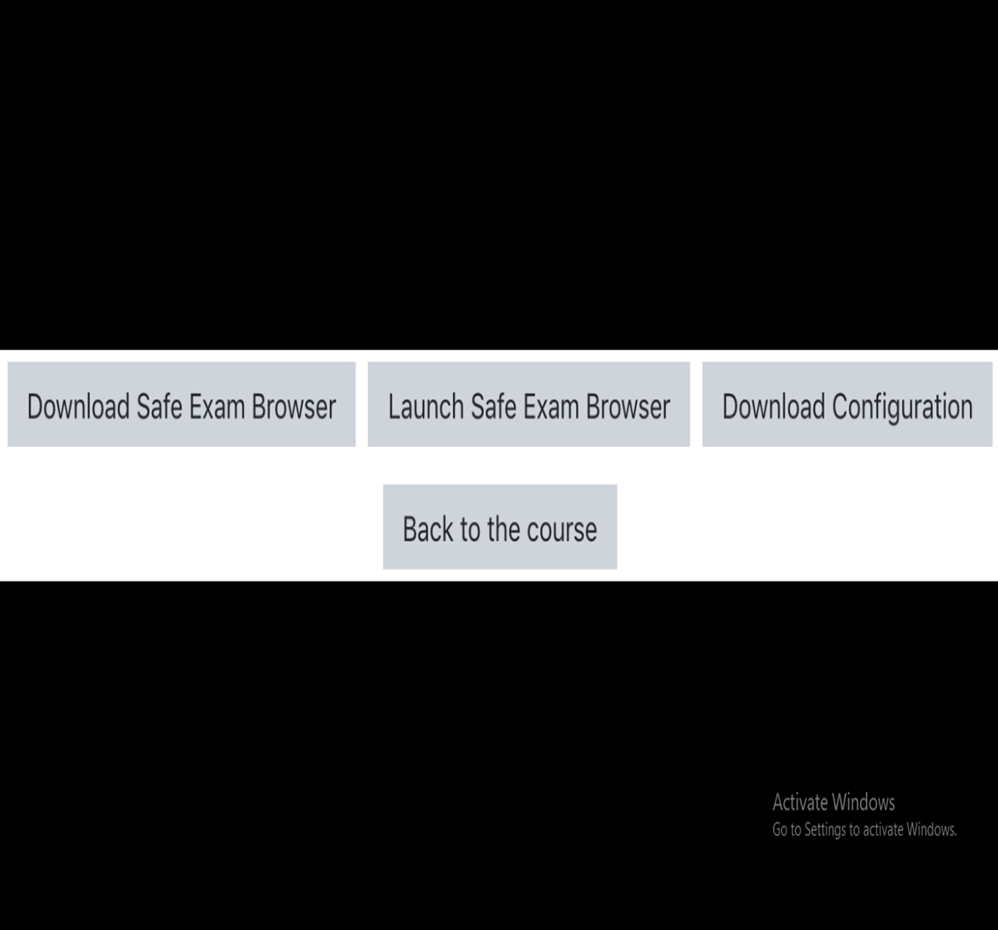
SEB config for Students

Slide 22
Moodle Proctoring – use webcam (camera)
Moodle proctoring plugin is a quiz access plugin to capture a user's picture via webcam to identify who is attempting the exam
It will capture the picture of the user's webcam automatically every 30 seconds and store it as a PNG image.
Admins can analyze the image of students after exams

Slide 23
enjoy your studies using moodle thank you

